Slide 1
Why German?

Slide 2
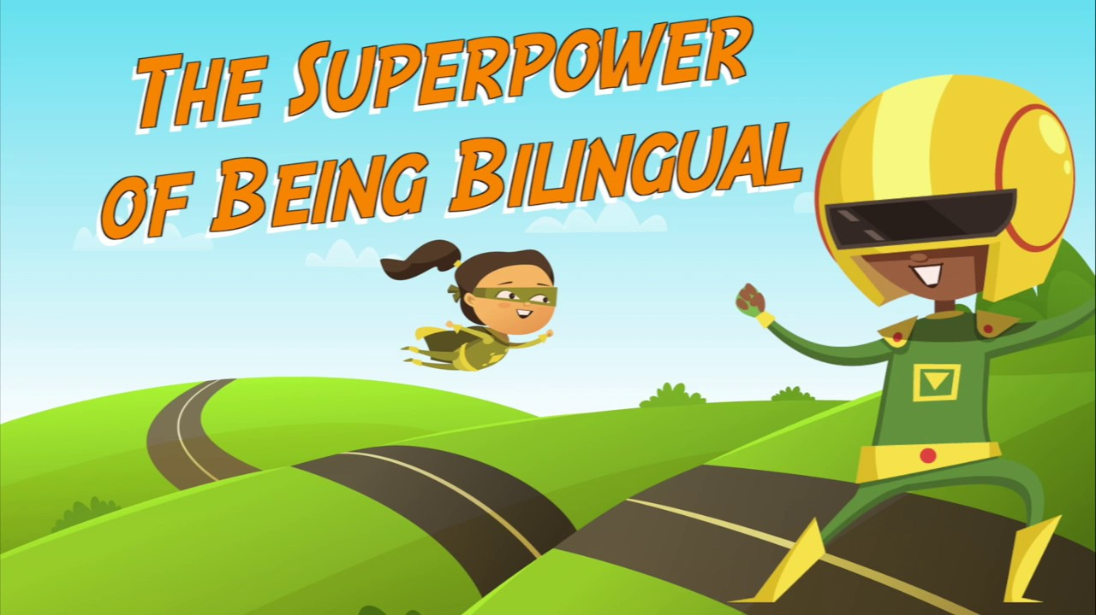
Bilingual Advantages!
Learning a new language
increases neural pathways
improves overall brain function & improves memory.

Slide 3
Multicultural Advantages
Experiencing a new language & culture
allows you to see your home culture through a different perspective
boosts creativity
increases potential for innovative ideas and solutions
builds self-confidence.

Slide 4
German @ UNM
First Major: 30 Credit Hours
Second Major: 24 Credit Hours
Minor: 15 Credit Hours
German Summer School (4 weeks; 6-7 credit hours)
Best Option: German along with another major!

Slide 5
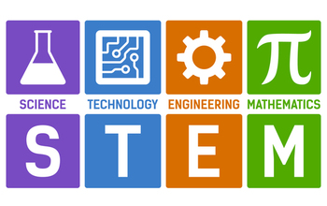
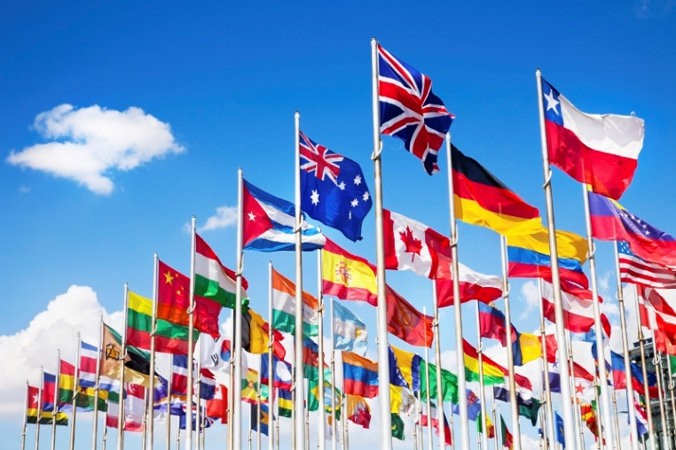
Potential Partner-Fields
Environmental Sciences
Business
Engineering & Math
Music & Fine Arts
Political Science
International Studies
Classics
Education
Languages & Linguistics
History & Philosophy

Slide 6
Why learn German?
(Especially since we live in New Mexico)
Greater Career Opportunities!
German opens career paths in an increasingly globalized economy.
STEM professionals with a German background are more likely to be hired and promoted over those who studied other foreign languages.
Those who study German are more likely to use German in their profession and career than those who studied other languages.

Slide 7
Advanced Study & Internships in Germany
400+ Universities
Masters & Doctoral Programs
No Tuition Fees
DAAD & Fulbright Fellowships, Scholarships & Internships
https://live0.zeit.de/zeit-germany/2018_01.pdf (jwilby@unm.edu)
Prep for Study in Germany?

Slide 8
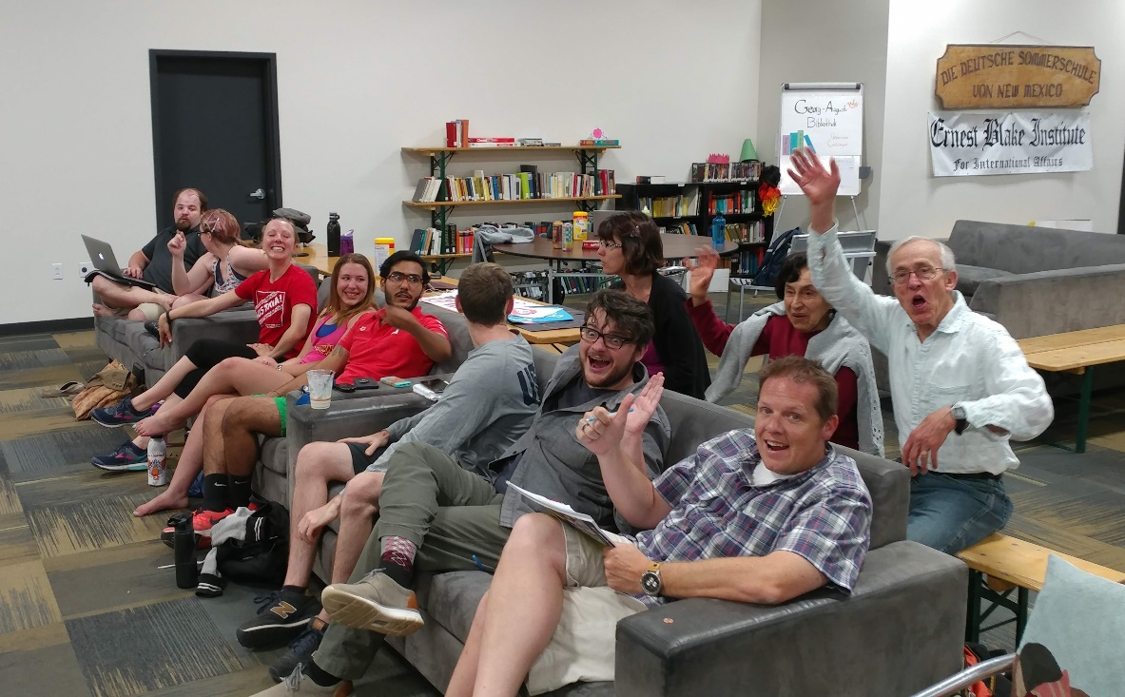
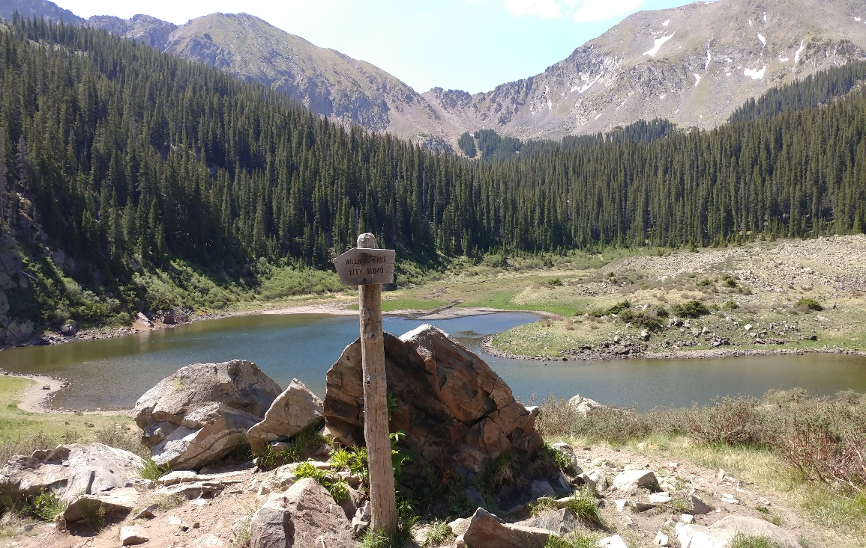
The German Summer School
Full Immersion (4 weeks)
6-7 Credit Hours (half a minor)
Upper-Division (300 level & above)

Slide 9
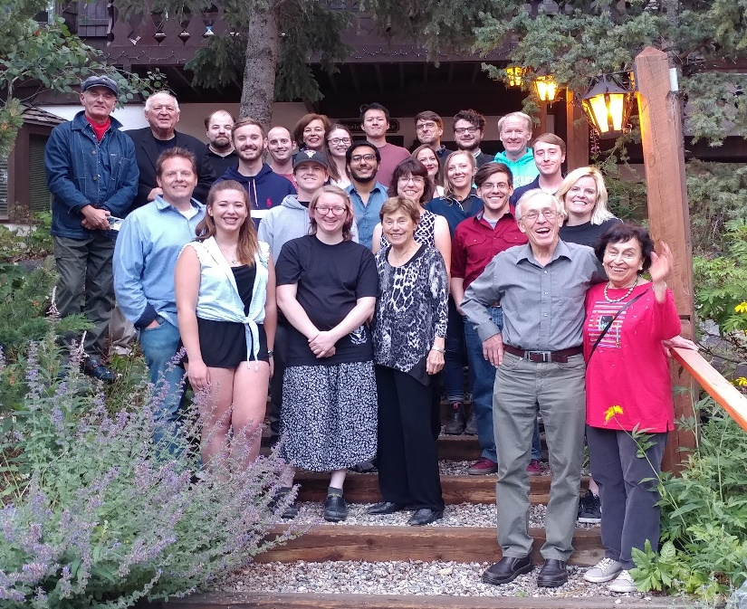
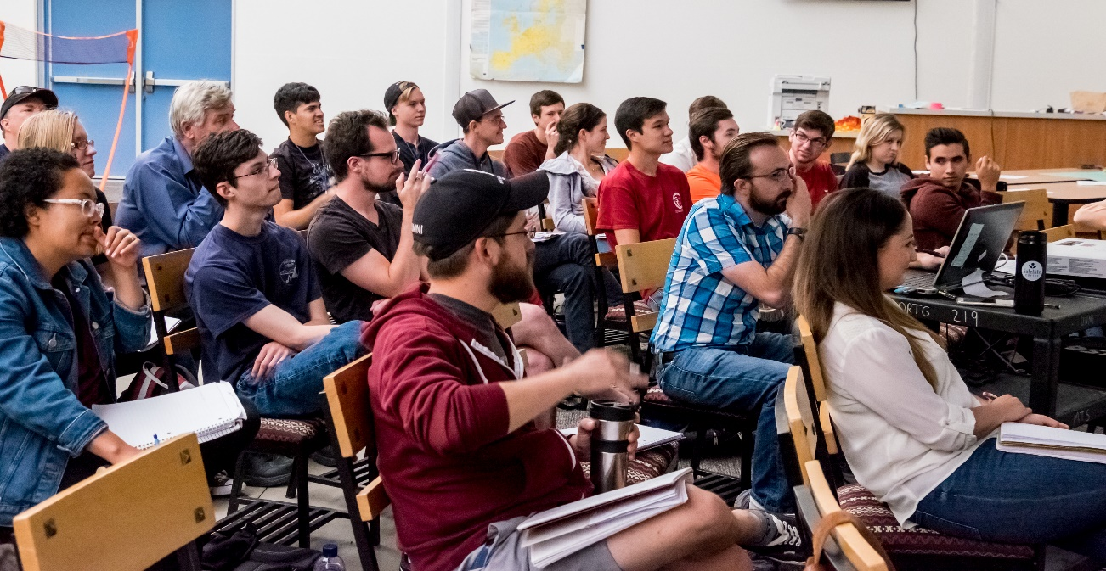
The German Summer School
More Intense than Study Abroad
Excellent Preparation for Study Abroad
Financial Assistance Available

Slide 10
Study Abroad @ UNM
The UNM GEO Office offers several study abroad programs, including:
University of Graz, Austria
University of Heidelberg, Germany
University of Duisburg-Essen, Germany
University of Würzburg, Germany
University of Halle, Germany

Slide 11
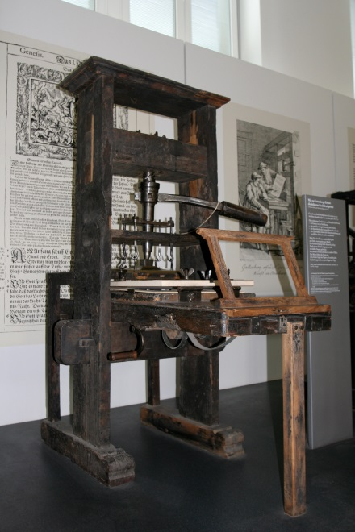
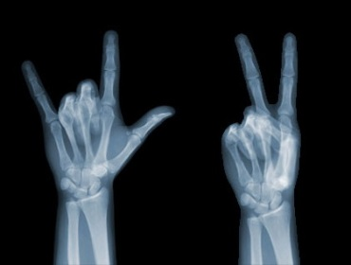
Research and Innovation:
4 of the world's 10 most innovative companies are located in Germany.
Germany ranks 3rd in the world in patent applications.

Slide 12
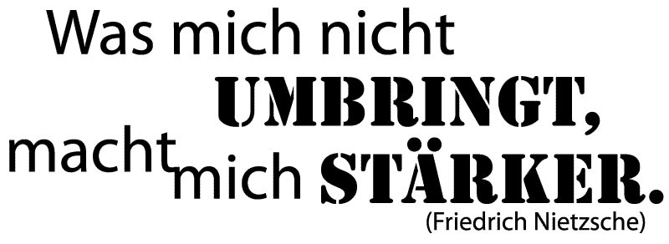
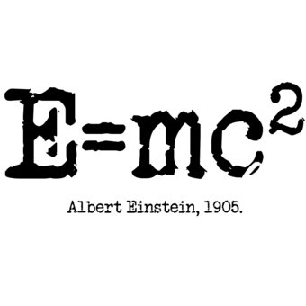
Cultural Heritage:
German is the language of Luther, Goethe, Nietzsche, Kafka, Mozart, Bach, Freud, Beethoven, Diesel, Siemens and Einstein as well as many other influential authors, artists, philosophers and scientists.
Knowing German helps better understand their work.

Slide 13
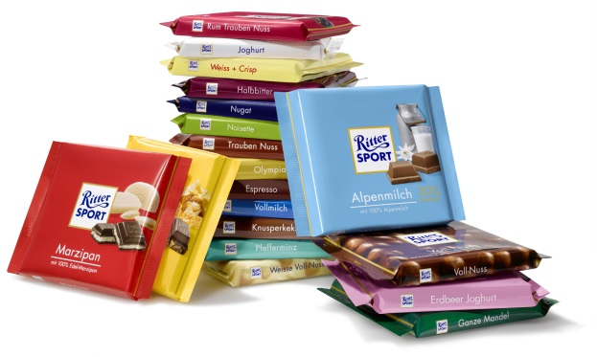
Economy: Germany has the world’s fourth largest economy and is the world’s second largest exporter.
Notes:
“the” statt “an” 11th
Once again bulltet points might be better

Slide 14
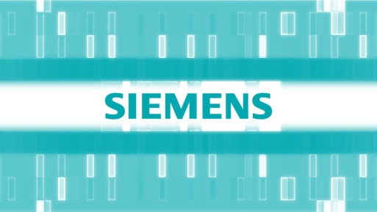
Knowing German creates business opportunities.
More than 2,000 major American firms do business in German-speaking countries.
More than 1,100 German companies do business in the US (=700,000 jobs).
Willy Brandt, a former German chancellor, once said: “If I’m selling to you, I speak your language. If I’m buying from you, dann müssen Sie Deutsch sprechen.”

Slide 15
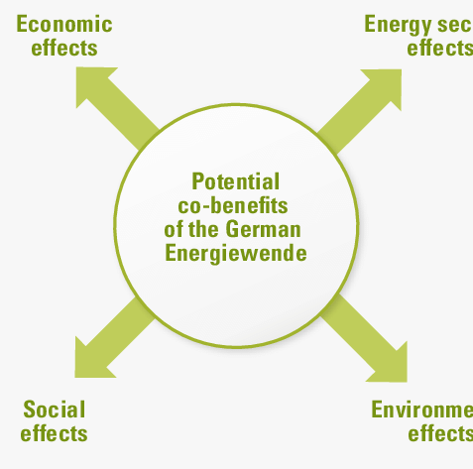
World Leadership: “Energiewende”
Germany is one of the most environmentally-conscious countries in the world, and is a leader in alternative energy development.

Slide 16
Travel and Tourism

Slide 17
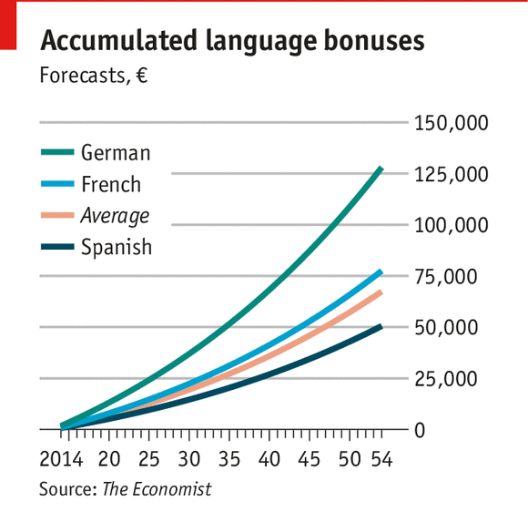
Knowing German can boost your annual salary in the US by 4%, in Europe by even more.

Slide 18
Forbes (3/2018)
It’s Not Liberal Arts And Literature Majors Who Are Most Underemployed
“And the major with the fewest underemployed graduates, according to the report, was ‘Foreign Languages, Literature, and Linguistics’.”
“In other words, for every cliché of a barista or bartender with a liberal arts degree, there were ten with a degree in business.”

Slide 19
BBC Capital (4/2019)
Why worthless humanities degrees may set you up for life.
“But in general, say Anders and others, the benefit of a humanities degree is the emphasis it puts on teaching students to think, critique and persuade – often in the grey areas where there isn’t much data available or you need to work out what to believe.”
“The biggest group of US humanities graduates, 15%, go on to management positions. That’s followed by 14% who are in in office and administrative positions, 13% who are in sales and another 12% who are in education, mostly teaching. Another 10% are in business and finance.”

Slide 20
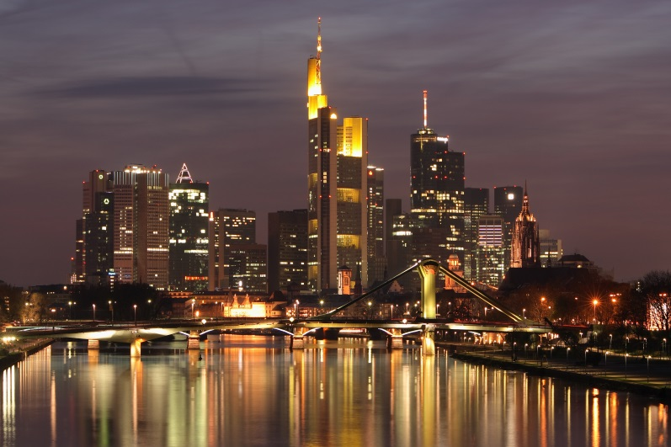
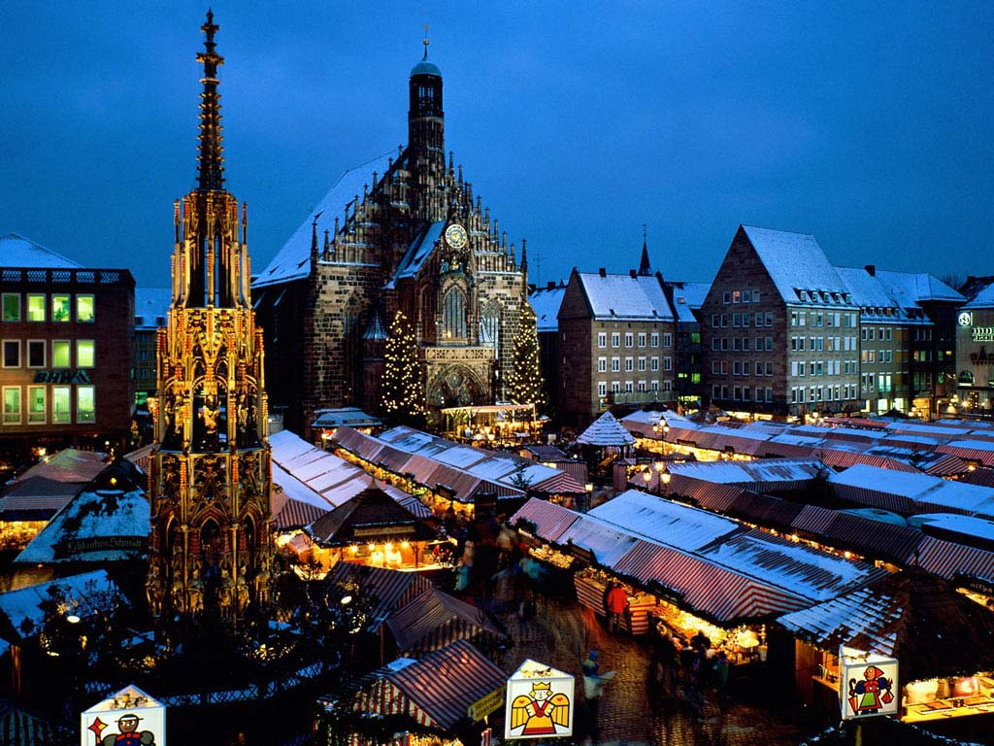
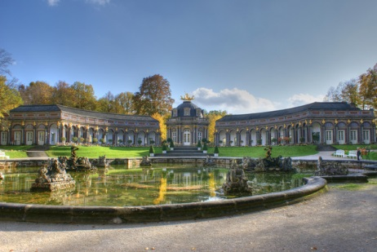
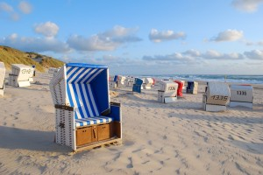
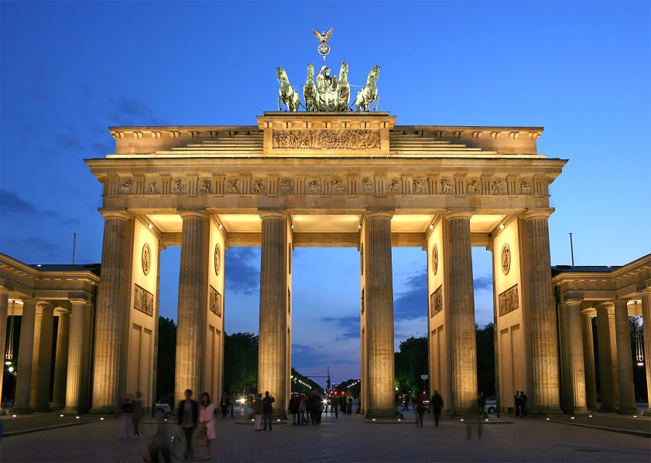
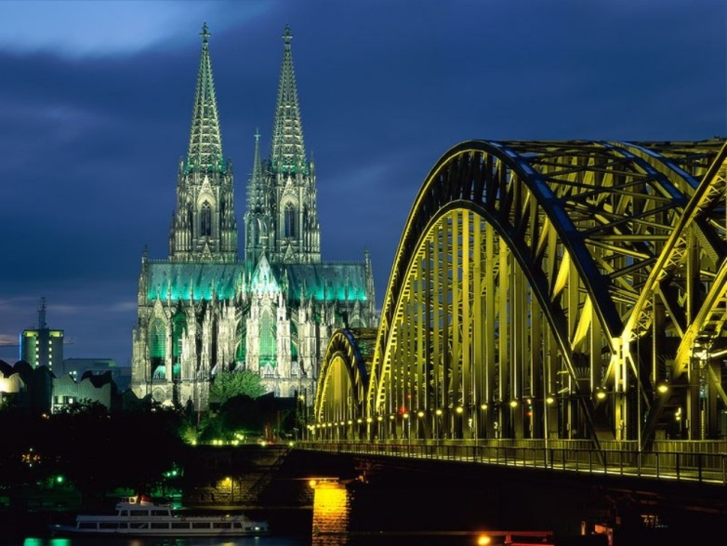
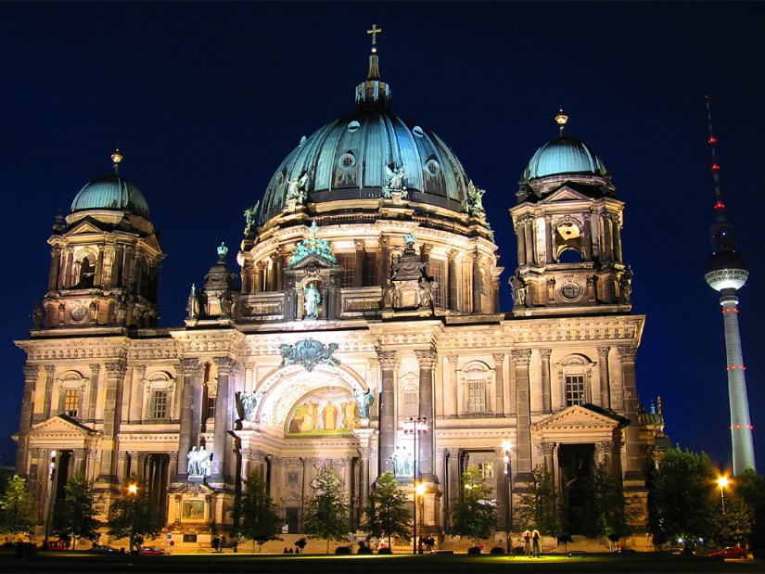
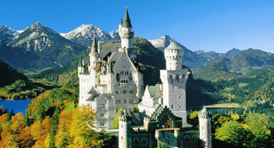
Deutschland ist wunderbar!

Slide 21
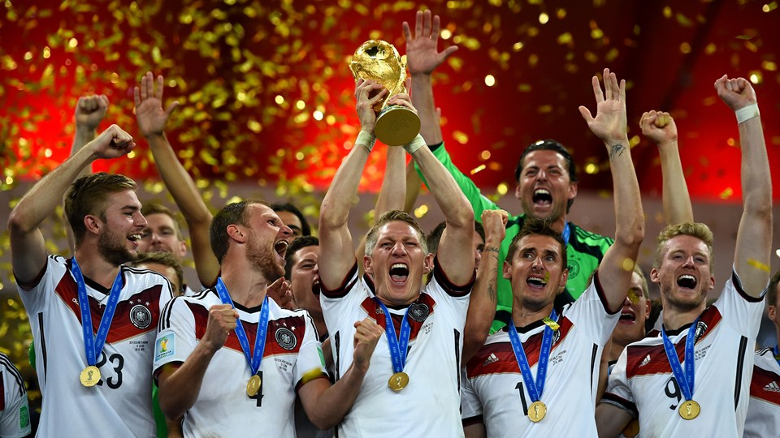
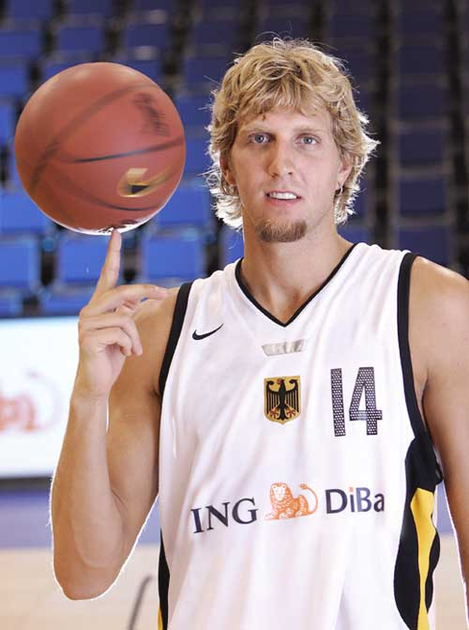
Deutschland ist Sportland!

Slide 22
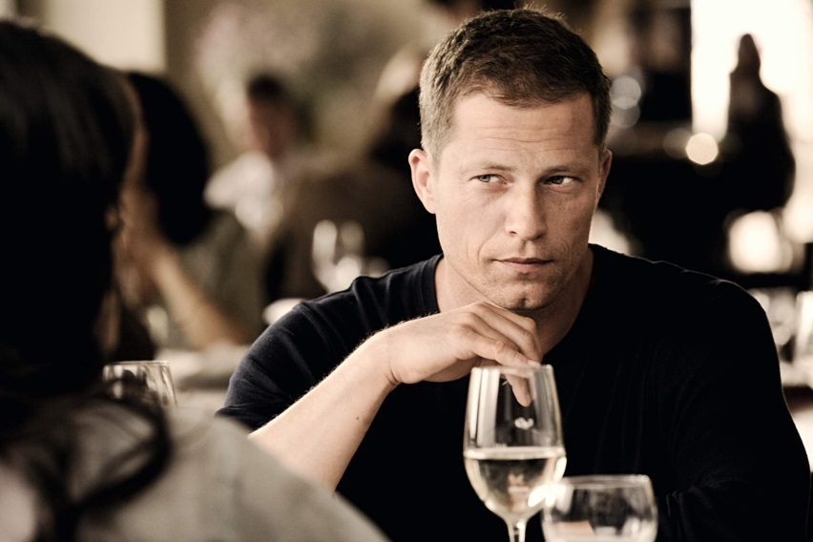
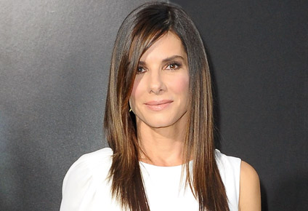
Deutschland ist Filmland!

Slide 23
German @ UNM
First Major: 30 Credit Hours
Second Major: 24 Credit Hours
Minor: 15 Credit Hours
German Summer School (4 weeks; 6-7 credit hours)
Best Option: German along with another major!

